Slide 1
TIAA Leadership Team Meeting Agenda
10:00 a.m., November 17th 2022
  Welcome and Agenda Overview Shyamal Parikh
  Approval of Minutes Mary Helmick
  Treasurer’s Report & Alumni Event cost Bob Rifkin
  Membership Count Larry James
  Membership Report Nancy Little/ Tammy
  Hernandez
  Website Status/Communications Team Richard Dotson
  Education Committee Update Richard Dotson
  November 10th Alumni Event Post-mortem All
  Committee Reports Committee Heads
  Old / New Business All
Next meeting: December 15th
Notes:
11/16/2022
1

Slide 2
TIAA Leadership Team Meeting Agenda
10:00 a.m., November 17th 2022
  Welcome and Agenda Overview Shyamal Parikh
  Approval of Minutes Mary Helmick
  Treasurer’s Report & Alumni Event cost Bob Rifkin
  Membership Count Larry James
  Membership Report Nancy Little/ Tammy
  Hernandez
  Website Status/Communications Team Richard Dotson
  Education Committee Update Richard Dotson
  November 10th Alumni Event Post-mortem All
  Committee Reports Committee Heads
  Old / New Business All
Next meeting: December 15th
Notes:
11/16/2022
2

Slide 3
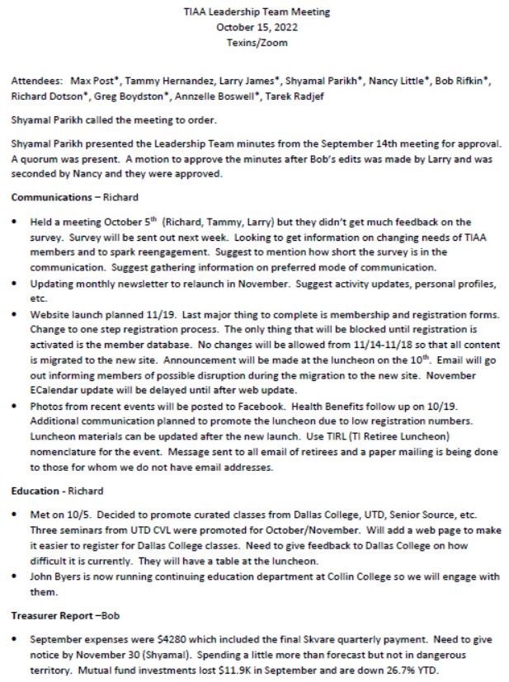

Slide 4
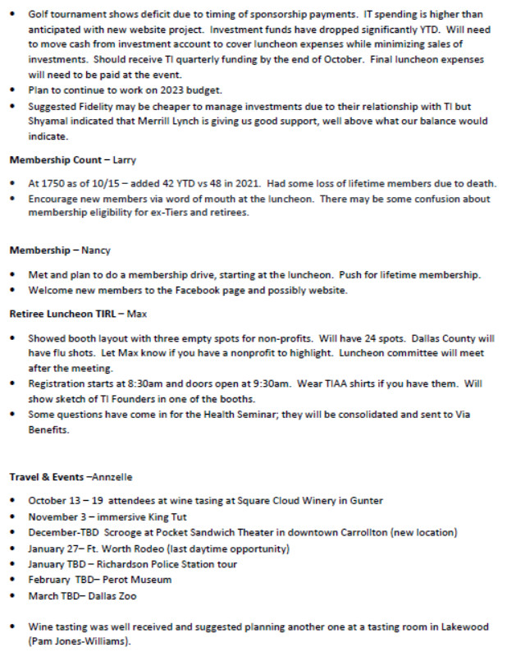

Slide 5
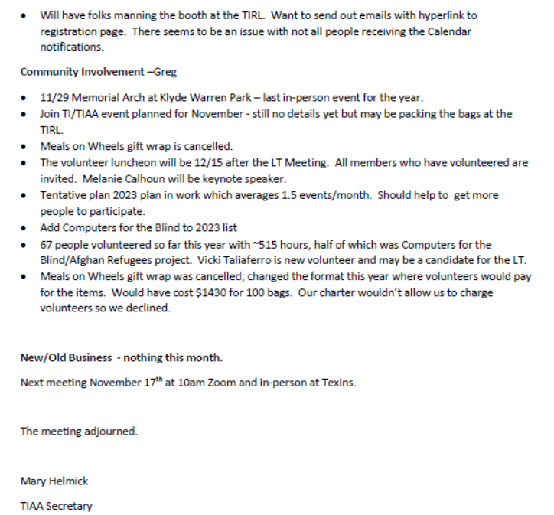

Slide 6
TIAA Leadership Team Meeting Agenda
10:00 a.m., November 17th 2022
  Welcome and Agenda Overview Shyamal Parikh
  Approval of Minutes Mary Helmick
  Treasurer’s Report & Alumni Event cost Bob Rifkin
  Membership Count Larry James
  Membership Report Nancy Little/ Tammy
  Hernandez
  Website Status/Communications Team Richard Dotson
  Education Committee Update Richard Dotson
  November 10th Alumni Event Post-mortem All
  Committee Reports Committee Heads
  Old / New Business All
Next meeting: December 15th
Notes:
11/16/2022
6

Slide 7
TIAA Leadership Team Meeting
Treasurer’s Report
November 17, 2022

Slide 8
Treasurer’s Activities
October expenses were $3,870, mostly admin and brokerage/accounting fees. King Tut, winery, and TIRL event income/expense will hit in November.
TIRL costs: Hampton Suites - $19,554 (paid); Sound Ideas - $13,254 (awaiting invoice). Not yet invoiced for ambulance, any other miscellaneous items.
Mutual fund investments gained $5.8K in October. Credit Union cash up $6.4K on TI quarterly funding.

Slide 9
2022 Financials

Slide 10
Fund Balance

Slide 11
Plans
Pay remaining TIRL expenses.
Complete first pass 2023 budget for presentation at December TIAA LT meeting.

Slide 12
TIAA Leadership Team Meeting Agenda
10:00 a.m., November 17th 2022
  Welcome and Agenda Overview Shyamal Parikh
  Approval of Minutes Mary Helmick
  Treasurer’s Report & Alumni Event cost Bob Rifkin
  Membership Count Larry James
  Membership Report Nancy Little/ Tammy
  Hernandez
  Website Status/Communications Team Richard Dotson
  Education Committee Update Richard Dotson
  November 10th Alumni Event Post-mortem All
  Committee Reports Committee Heads
  Old / New Business All
Next meeting: December 15th
Notes:
11/16/2022
12

Slide 13

Total TIAA Membership as of 10/31/2022
3079* (12/31/06)
2407 (6/30/08)
YTD New= 47
1755 (10/31/22)
1740 (10/31/14)
1638 (12/31/17)
1596 (12/31/16)
1723 (12/31/21)
1665 (12/31/20)
1600 (12/31/19)
1504 (1/31/16)
“COVID Year Free”
2020 through 2022
*Total members INCLUDING 996 “Auto Enrolls”
12/14 12/15 12/16 12/17 12/18 12/19 12/20 12/21 10/22
Lifetime 785 806 838 854 892 903 907 903 898

Slide 14
TIAA Leadership Team Meeting Agenda
10:00 a.m., November 17th 2022
  Welcome and Agenda Overview Shyamal Parikh
  Approval of Minutes Mary Helmick
  Treasurer’s Report & Alumni Event cost Bob Rifkin
  Membership Count Larry James
  Membership Report Nancy Little/ Tammy
  Hernandez
  Website Status/Communications Team Richard Dotson
  Education Committee Update Richard Dotson
  November 10th Alumni Event Post-mortem All
  Committee Reports Committee Heads
  Old / New Business All
Next meeting: December 15th
Notes:
11/16/2022
14

Slide 15
TIAA Leadership Team Meeting Agenda
10:00 a.m., November 17th 2022
  Welcome and Agenda Overview Shyamal Parikh
  Approval of Minutes Mary Helmick
  Treasurer’s Report & Alumni Event cost Bob Rifkin
  Membership Count Larry James
  Membership Report Nancy Little/ Tammy
  Hernandez
  Website Status/Communications Team Richard Dotson
  Education Committee Update Richard Dotson
  November 10th Alumni Event Post-mortem All
  Committee Reports Committee Heads
  Old / New Business All
Next meeting: December 15th
Notes:
11/16/2022
15

Slide 16
November Communications committee update
Team met Nov. 2
(Richard, Larry, Tammy)
Website launch still on for weekend of Nov. 19
  Finalizing registration system, domain name move protocols
  If name switchover has issues we can roll back and try again Sunday or Thanksgiving week
  Go to dev site https://xeara.org/tialumni/
Working on new monthly newsletter to roll out after Thanksgiving week
  Gary’s TI Founders Community Impact award
  Recap of TIRL event
  BEST call for volunteers
  List of upcoming events
Reviewed member survey (109 respondents)
  About half from DFW area, half from elsewhere in Texas or US.
  None from outside U.S.
  96% say email is the preferred method of communications
  40% of respondents say they never go to a TIAA function
  An even split of people prefer online, or in person events; half of respondents prefer a mix of both
  People equally said they prefer morning, or afternoon, or anytime to get together for a TIAA event
  Most members have been with TIAA more than 10 years (24% more than 20 years); however, 20% of members are new (0-5 years)

Slide 17
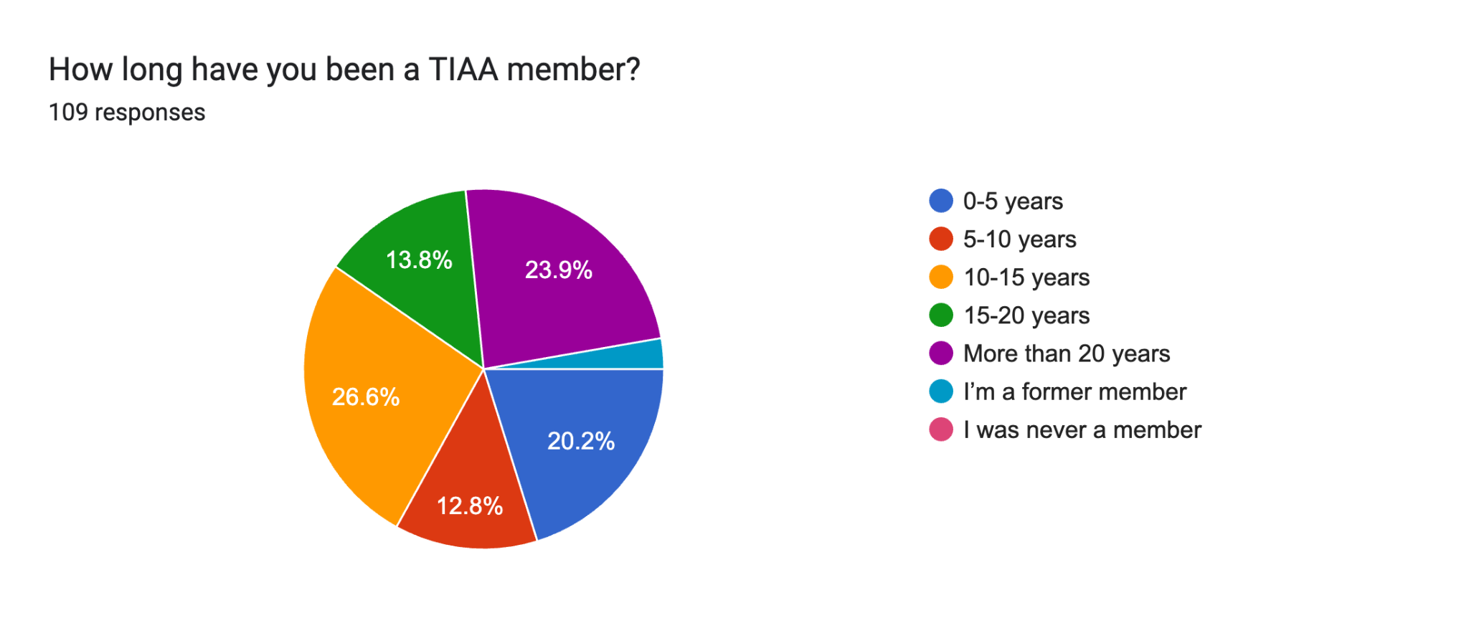
Most have been members more than 10 years.
However, 20% are 5 years of less.

Slide 18
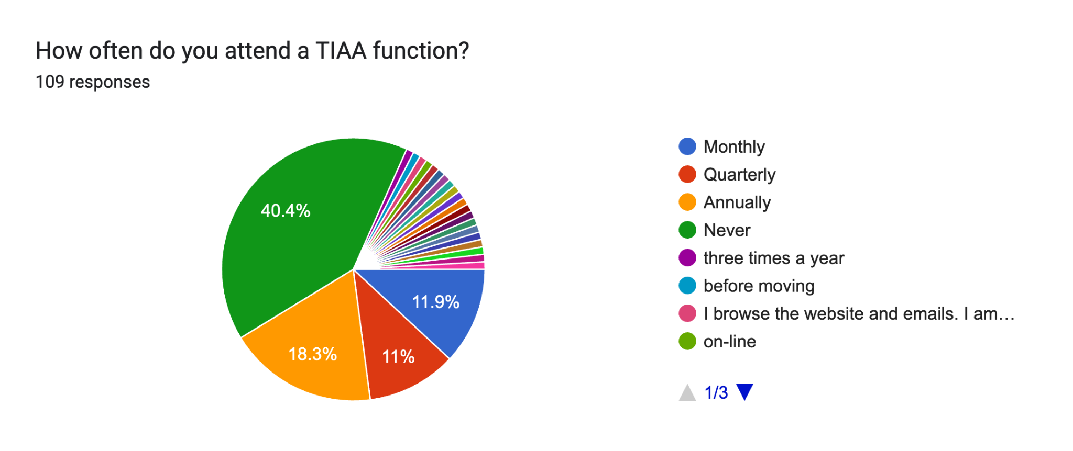
More than 40% have never attended an event.

Slide 19
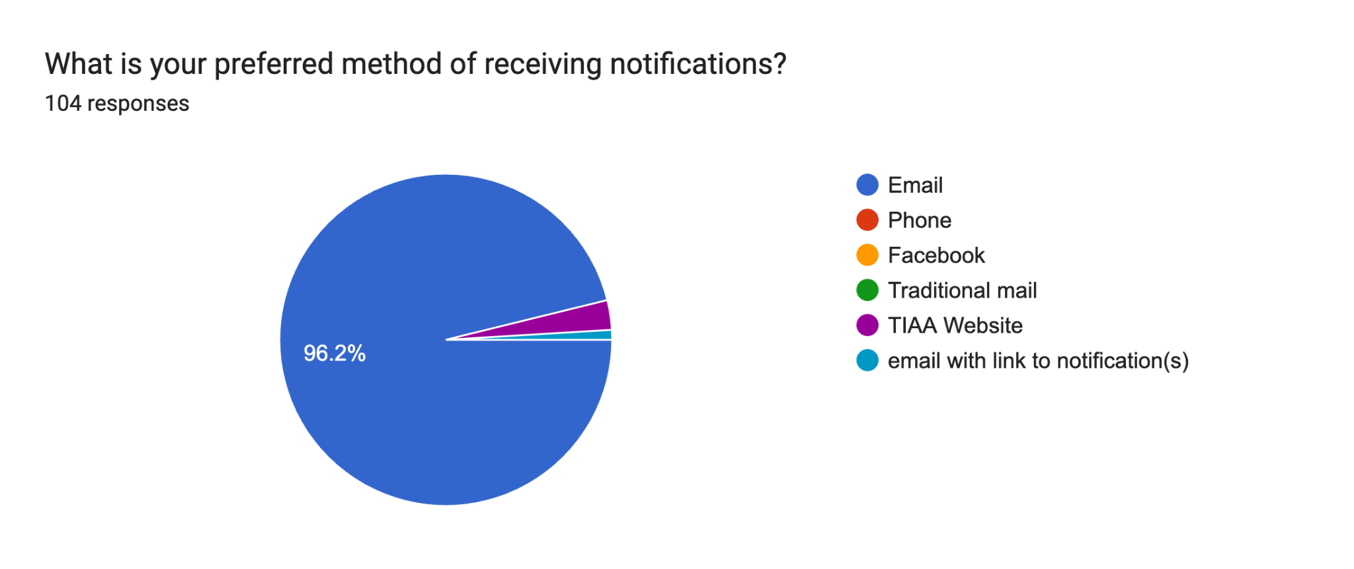
Email is the boss of notifications!

Slide 20
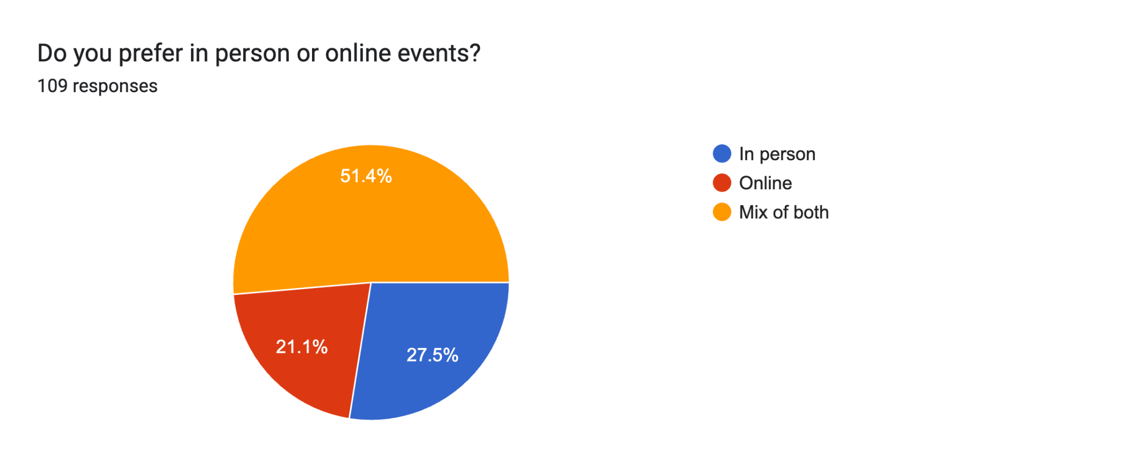

Slide 21
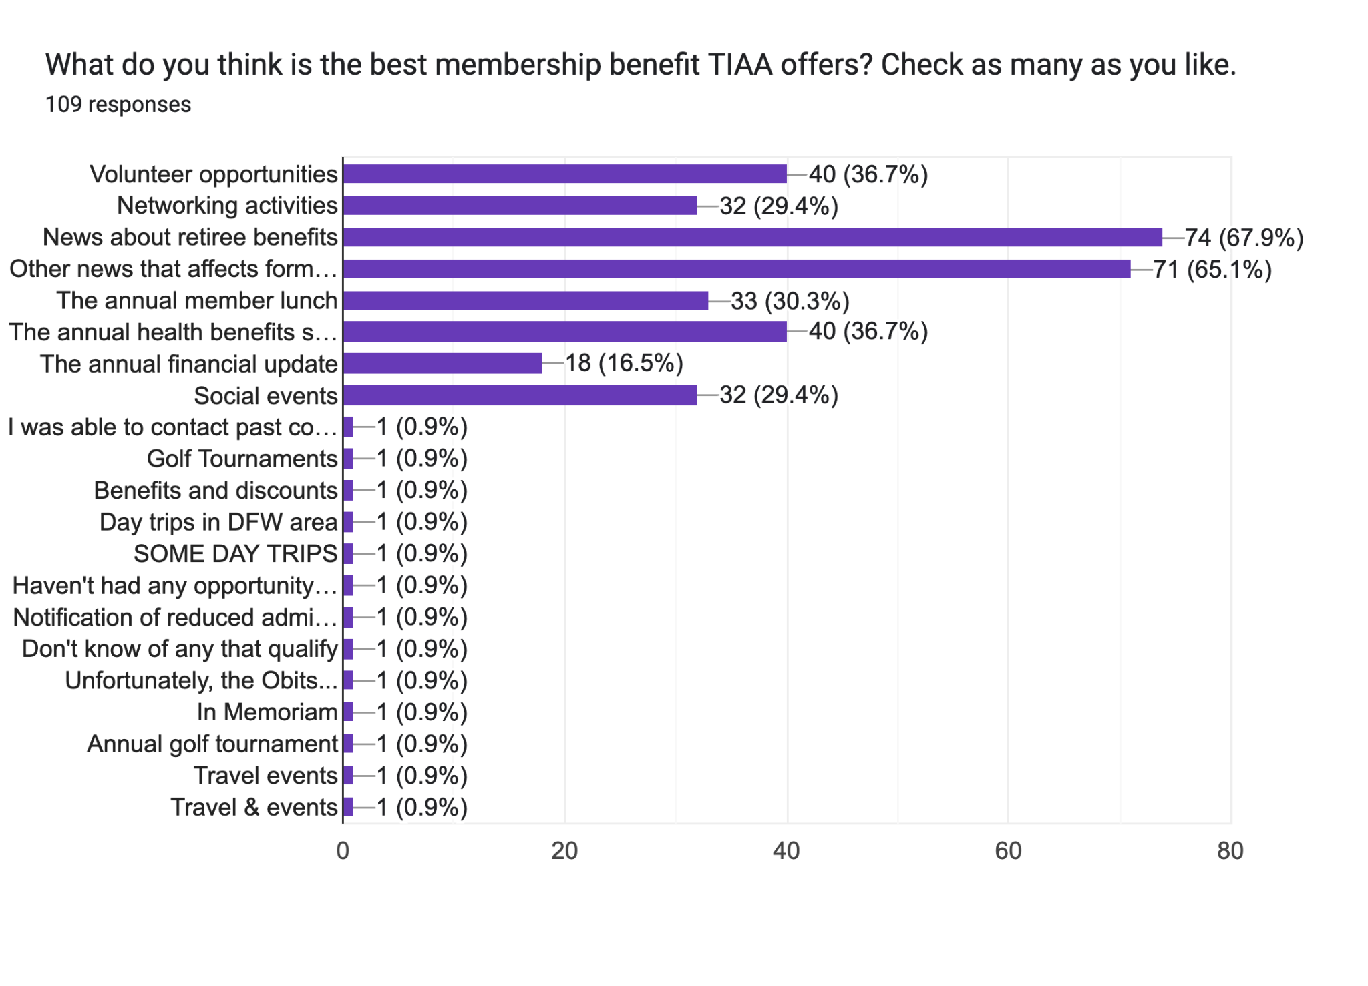

Slide 22
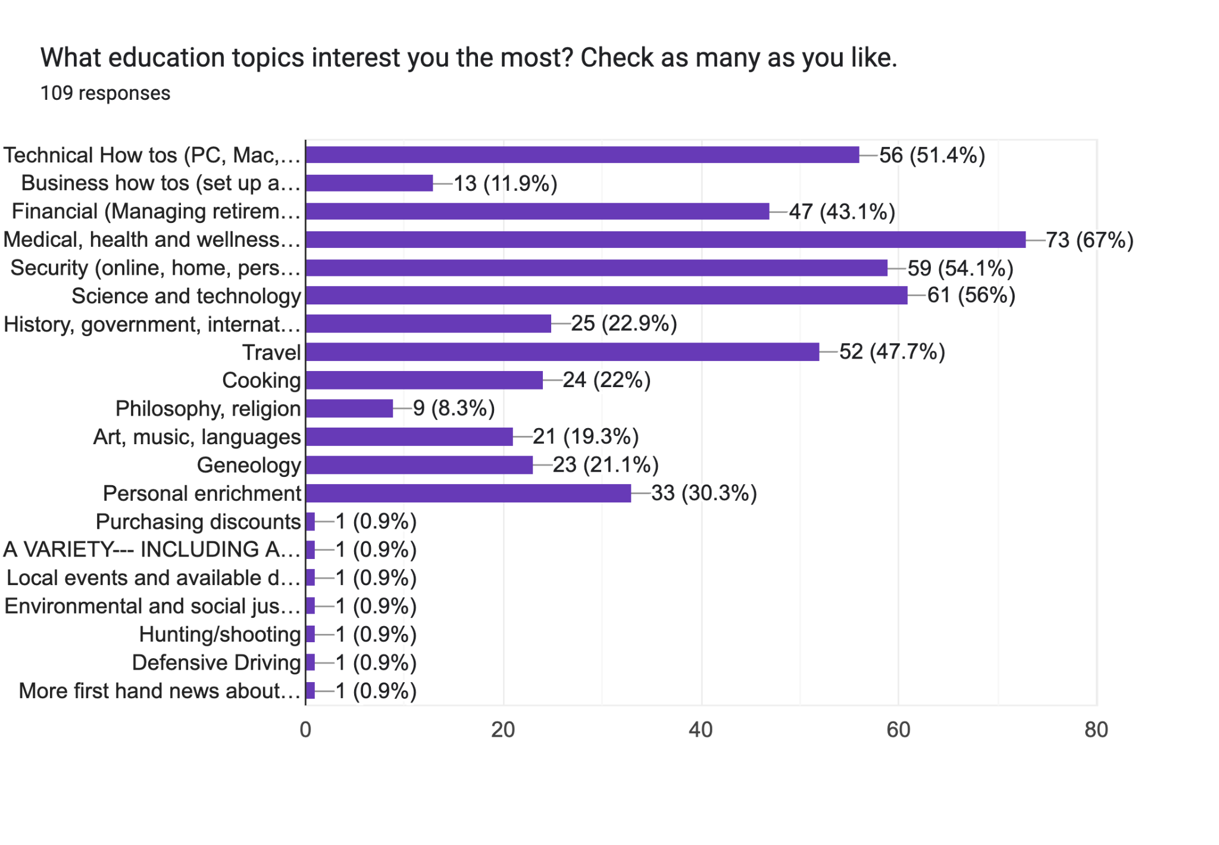

Slide 23
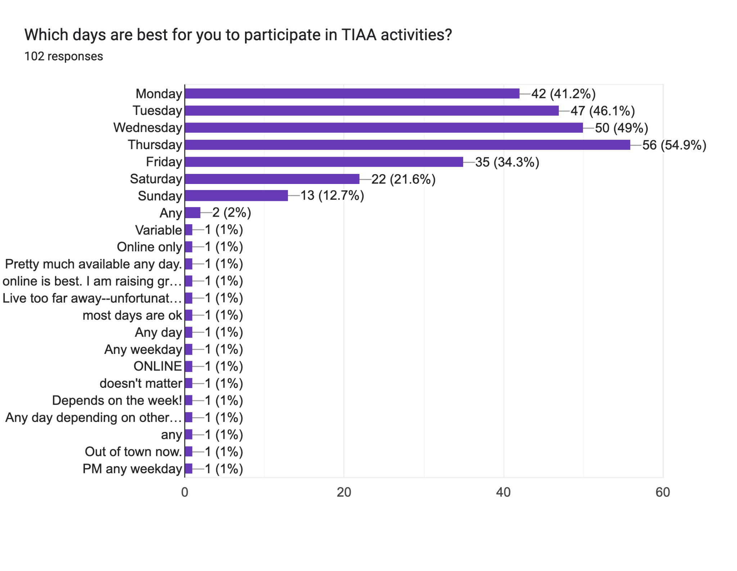

Slide 24
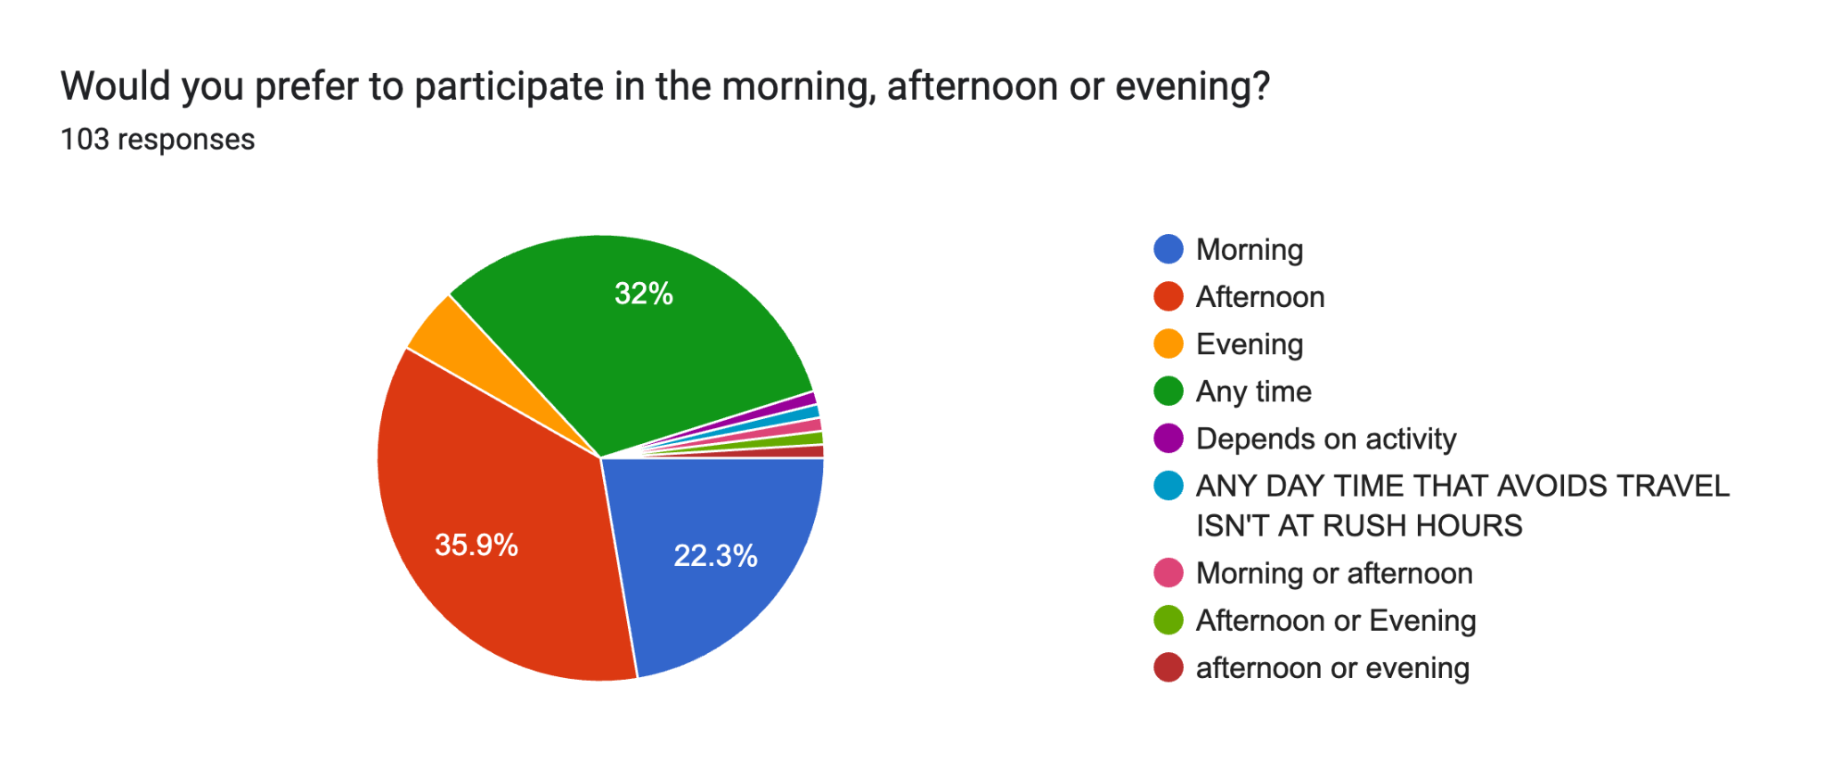

Slide 25
TIAA Leadership Team Meeting Agenda
10:00 a.m., November 17th 2022
  Welcome and Agenda Overview Shyamal Parikh
  Approval of Minutes Mary Helmick
  Treasurer’s Report & Alumni Event cost Bob Rifkin
  Membership Count Larry James
  Membership Report Nancy Little/ Tammy
  Hernandez
  Website Status/Communications Team Richard Dotson
  Education Committee Update Richard Dotson
  November 10th Alumni Event Post-mortem All
  Committee Reports Committee Heads
  Old / New Business All
Next meeting: December 15th
Notes:
11/16/2022
25

Slide 26
Education committee update
Committee met Nov. 7 (Richard, Max, Larry, Tammy, Tarek, Shyamal)
Plan to set up info pages for Dallas College, Collin County, UTD after website launch
  Dallas College is updating and renaming program
  Reached out to UTD team at TIRL and following up
Each team member has the action to find one speaker who can do a Zoom seminar for us next year
  Must be interesting and entertaining
  Must fit within the member interest zones found in survey (anything from personal enrichment to personal finance)
Richard scoping out curated content that may make sense for our audience
  Self service online classes
  Group topics we can use for in person events
Looking at possibly combining travel with education events. For example….
  Glass blowing class in Oklahoma
  Guided hikes
  Historic tours

Slide 27
TIAA Leadership Team Meeting Agenda
10:00 a.m., November 17th 2022
  Welcome and Agenda Overview Shyamal Parikh
  Approval of Minutes Mary Helmick
  Treasurer’s Report & Alumni Event cost Bob Rifkin
  Membership Count Larry James
  Membership Report Nancy Little/ Tammy
  Hernandez
  Website Status/Communications Team Richard Dotson
  Education Committee Update Richard Dotson
  November 10th Alumni Event Post-mortem All
  Committee Reports Committee Heads
  Old / New Business All
Next meeting: December 15th
Notes:
11/16/2022
27

Slide 28
TIAA Leadership Team Meeting Agenda
10:00 a.m., November 17th 2022
  Welcome and Agenda Overview Shyamal Parikh
  Approval of Minutes Mary Helmick
  Treasurer’s Report & Alumni Event cost Bob Rifkin
  Membership Count Larry James
  Membership Report Nancy Little/ Tammy
  Hernandez
  Website Status/Communications Team Richard Dotson
  Education Committee Update Richard Dotson
  November 10th Alumni Event Post-mortem All
  Committee Reports Committee Heads
  Old / New Business All
Next meeting: December 15th
Notes:
11/16/2022
28

Slide 29
Travel & Events Committee
November 2022

Slide 30
Travel & Events Committee
November 2022
Recap:
November 3rd - Immersive King Tut at Lighthouse Art Space. Eleven folks attended. Interesting concept with visuals that were constantly changing. A big plus was 75% off everything in gift shop! Early Christmas shopping was done by all.
TIRL was a big success
Future Events:
December 8th - Scrooge at Pocket Sandwich Theater (drive yourself)
2023
January 27th - Ft. Worth Rodeo.
February TBD - Perot Museum – Tammy checking to see if TI retirees can get in free.
March 21 - Dallas Zoo
Richardson Police Dept tour, TBD based on police chief availability.
-- No meeting in December, next meeting is January 9. --

Slide 31
Community Involvement
November 2022

Slide 32
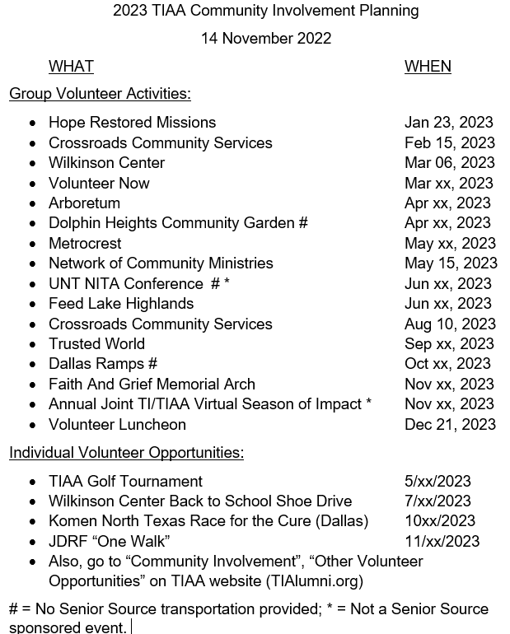

Slide 33
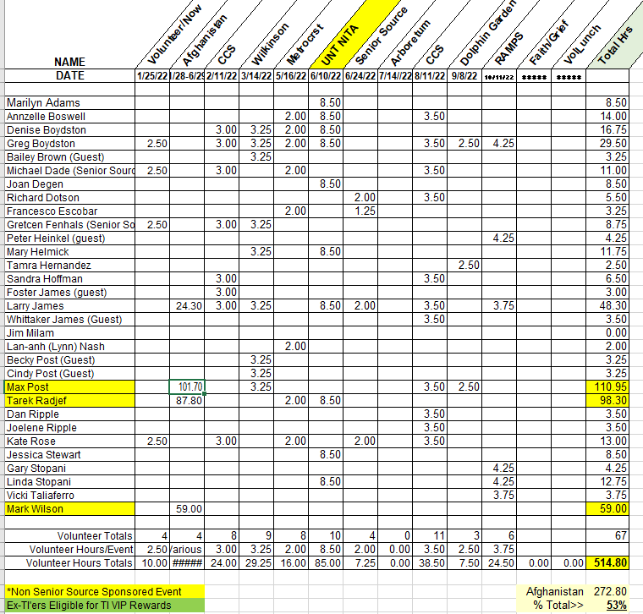

Slide 34
TIAA Leadership Team Meeting Agenda
10:00 a.m., November 17th 2022
  Welcome and Agenda Overview Shyamal Parikh
  Approval of Minutes Mary Helmick
  Treasurer’s Report & Alumni Event cost Bob Rifkin
  Membership Count Larry James
  Membership Report Nancy Little/ Tammy
  Hernandez
  Website Status/Communications Team Richard Dotson
  Education Committee Update Richard Dotson
  November 10th Alumni Event Post-mortem All
  Committee Reports Committee Heads
  Old / New Business All
Next meeting: December 15th
Notes:
11/16/2022
34

Slide 35
TIAA Leadership Team Meeting Agenda
10:00 a.m., November 17th 2022
  Welcome and Agenda Overview Shyamal Parikh
  Approval of Minutes Mary Helmick
  Treasurer’s Report & Alumni Event cost Bob Rifkin
  Membership Count Larry James
  Membership Report Nancy Little/ Tammy
  Hernandez
  Website Status/Communications Team Richard Dotson
  Education Committee Update Richard Dotson
  November 10th Alumni Event Post-mortem All
  Committee Reports Committee Heads
  Old / New Business All
Next meeting: December 15th
Notes:
11/16/2022
35

